Slide 1
Rapid Deployment of Anomaly Detection Models
for Large Number of Emerging KPI Streams

Slide 2
KPI(Key Performance Indicators, say CPU utilization, number of queries per second, response latency))
What is KPI and how to use it?
The spike, dip on the KPI stream usually can reflect the anomalies
Deficiencies of previous methods
Traditional statistical algorithms: Manual algorithm selection and parameter tuning for every newly emerging KPI stream becomes infeasible
Supervised Learning: Manual anomaly labeling for a large number of newly emerging KPI streams is not feasible either.

Slide 3
To solve these issues: ADS (Anomaly Detection through Self-training) -- Semi-Supervised Learning
For lots of historical KPI streams (using ROCKA to divide them into several clusters. NOTE: quantity of clusters far less than the quantity of streams)
For a new KPI stream, if it can match the historical pattern then add to that pattern, else establish a new cluster.
Each cluster has some striking features to be identified, and these features are obtained during the process when a KPI stream was classified.
Above KPI streams construct the training set(with labels)
After extracting features for both the labeled KPI streams on cluster centroids and the unlabeled new KPI stream, they try to learn a model which is based on both labeled and unlabeled data(using CPLE)

Slide 4
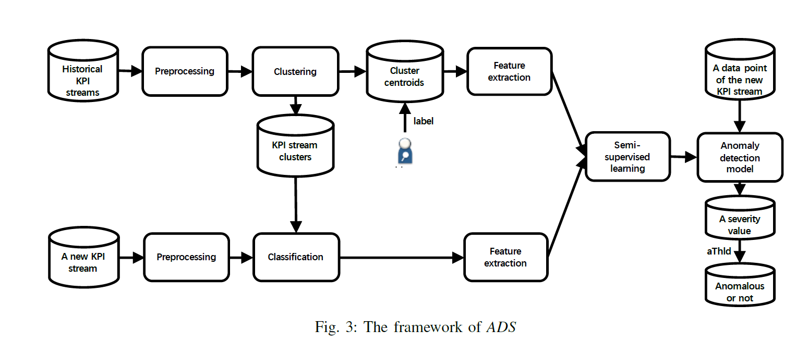
Detailed Process
Reference: Rapid Deployment of Anomaly Detection Models for Large Number of Emerging KPI Streams. Jiahao Bu, Ying Liu, et al. IPCCC 2018.

Slide 5
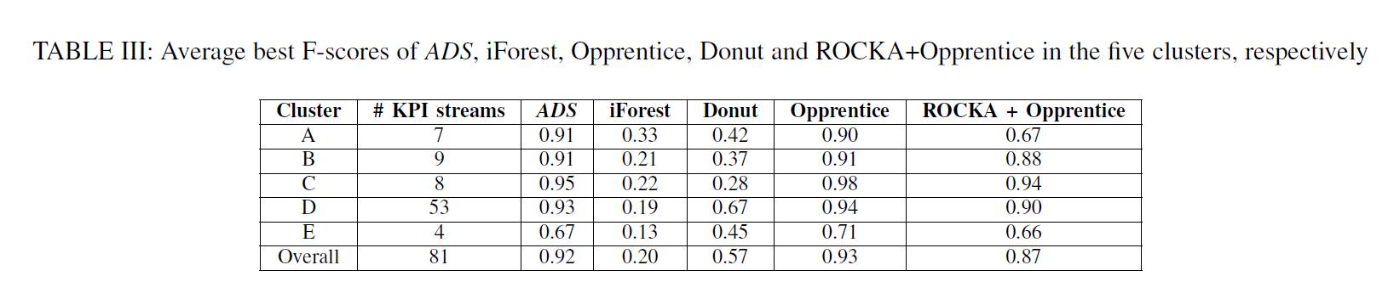
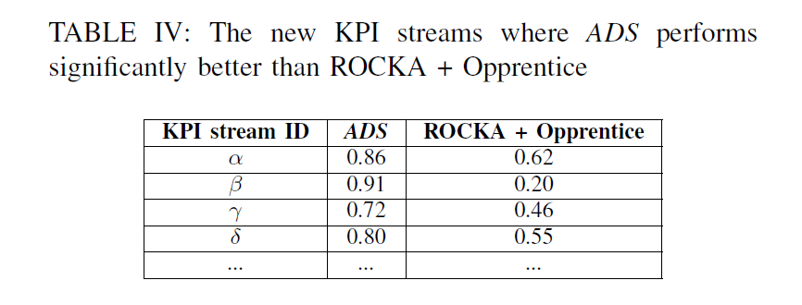
Experiment Result
Reference: Rapid Deployment of Anomaly Detection Models for Large Number of Emerging KPI Streams. Jiahao Bu, Ying Liu, et al. IPCCC 2018.

Slide 6
Inspiration
Their method to handle the temporal data -- The feature extraction, training, and classification (detection) in ADS are all designed to work with individual data points. (The KPI stream is similar with the form of log, if the log of Ali can similarly match this form, I reckon we can consider this approach)
Clustering(Reduce the examplars) && Semi-supervised learning.(Curtail the time cost on labeling in supervised learning and boost the accuracy of unsupervised learning)
Some efficient framework such as ROCKA && CPLE.

